Slide 1


T-BANK MANAGEMENT SYSTEM
——TBT

Slide 2
This PPT will help you understand our software effectively. It contains the introduction of various parts of TBMS. Click NEXT to enjoy this feast.
NEXT→

Slide 3
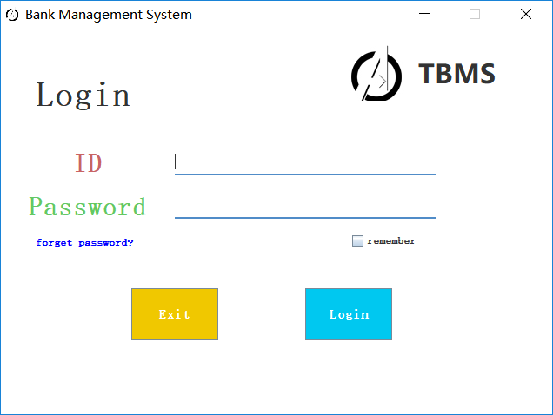
This is our login interface. Enter your work number and password here. If your password is wrong, don't worry. Our system will prompt and help you find your password
NEXT→

Slide 4
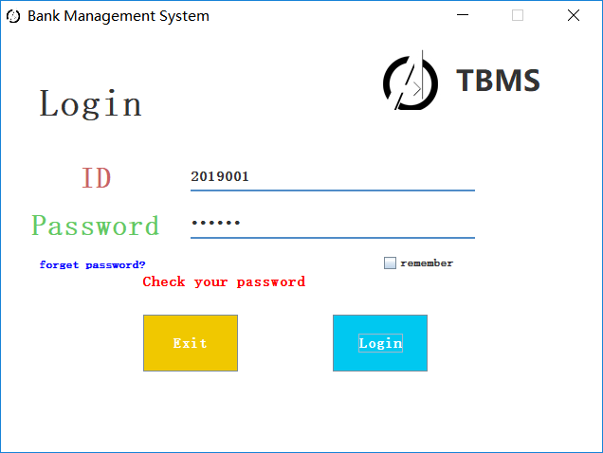
←Click Picture
NEXT→

Slide 5
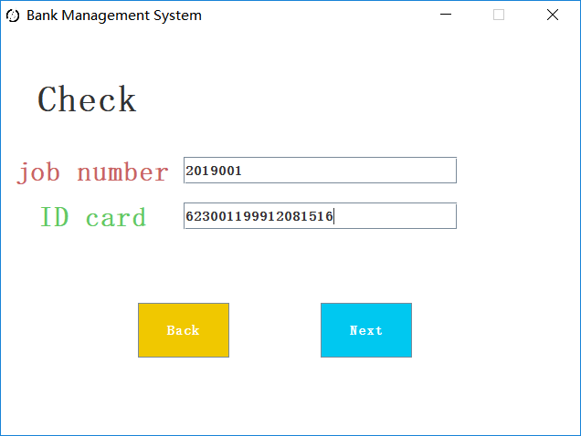
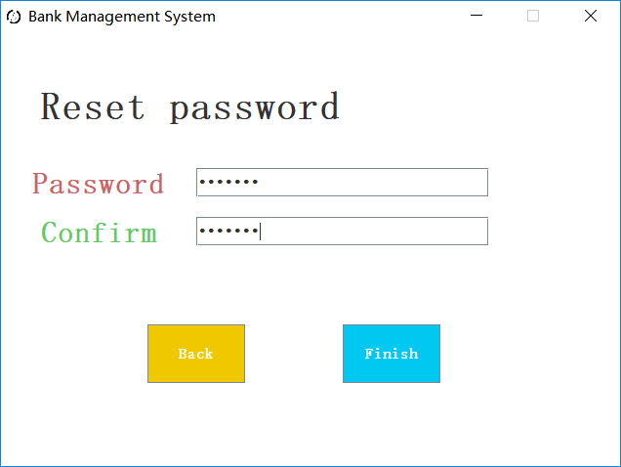
For the sake of security, we only design the method of using ID card + work number to retrieve the password.
Use this interface to set your new password
NEXT→

Slide 6
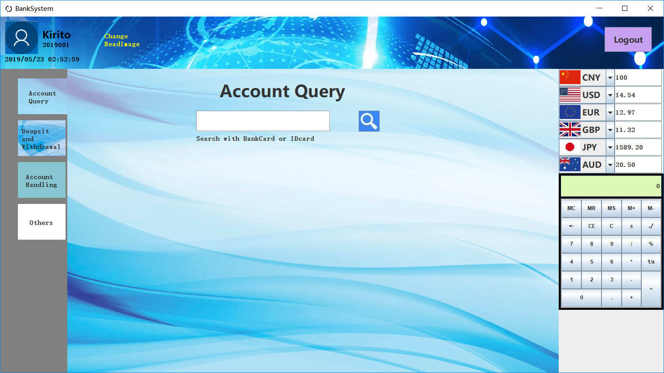
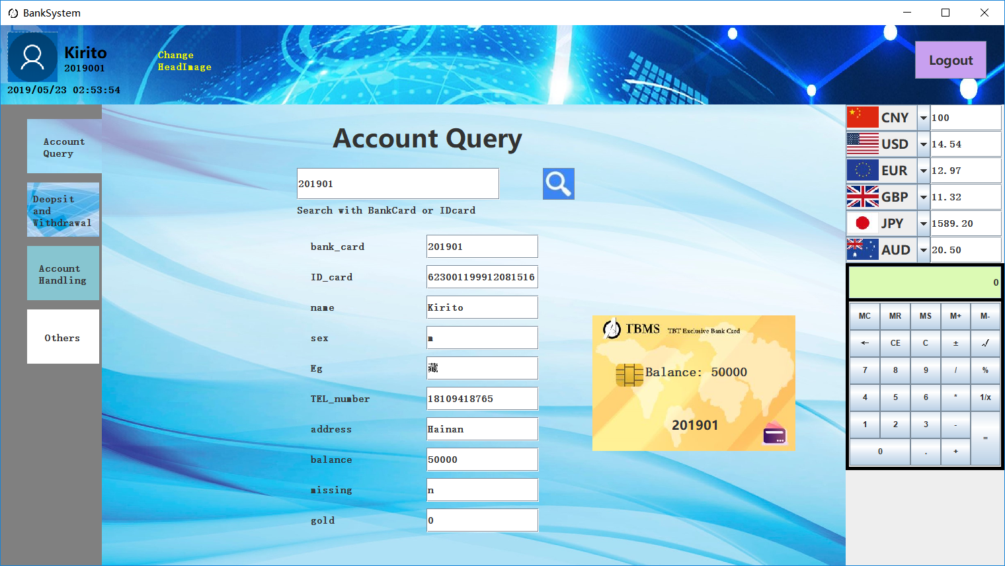
Use this interface to query customer information
NEXT→

Slide 7
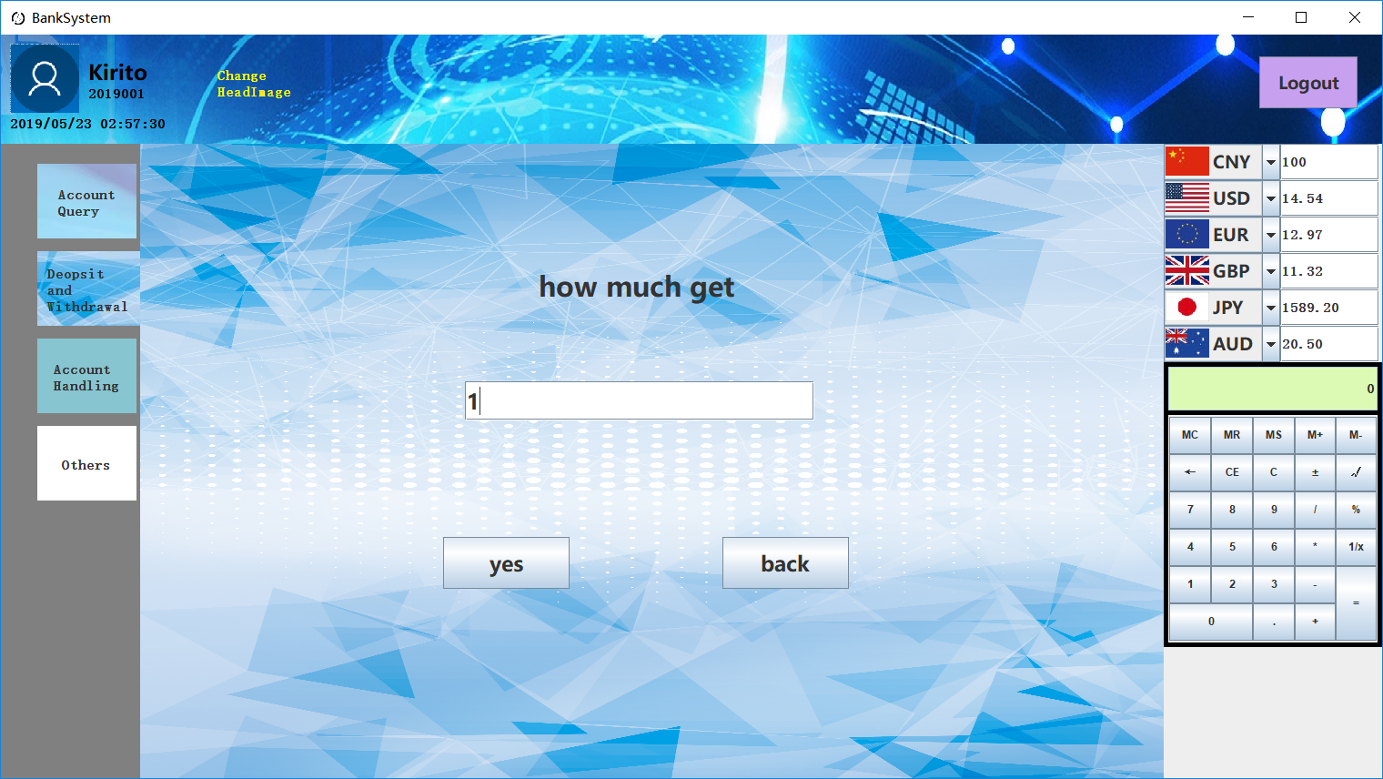
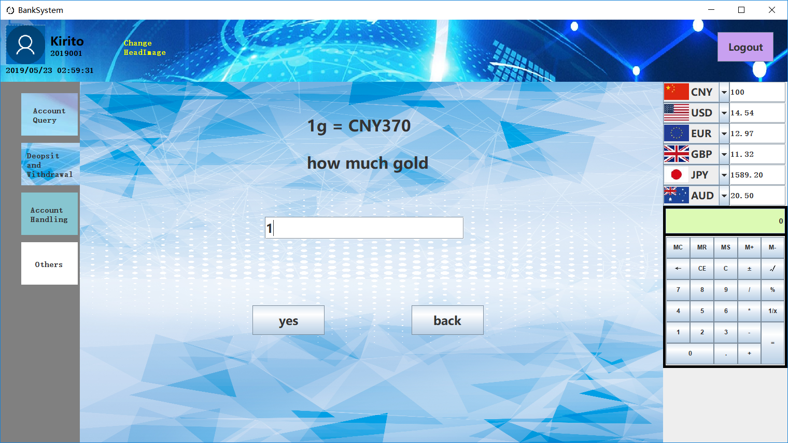
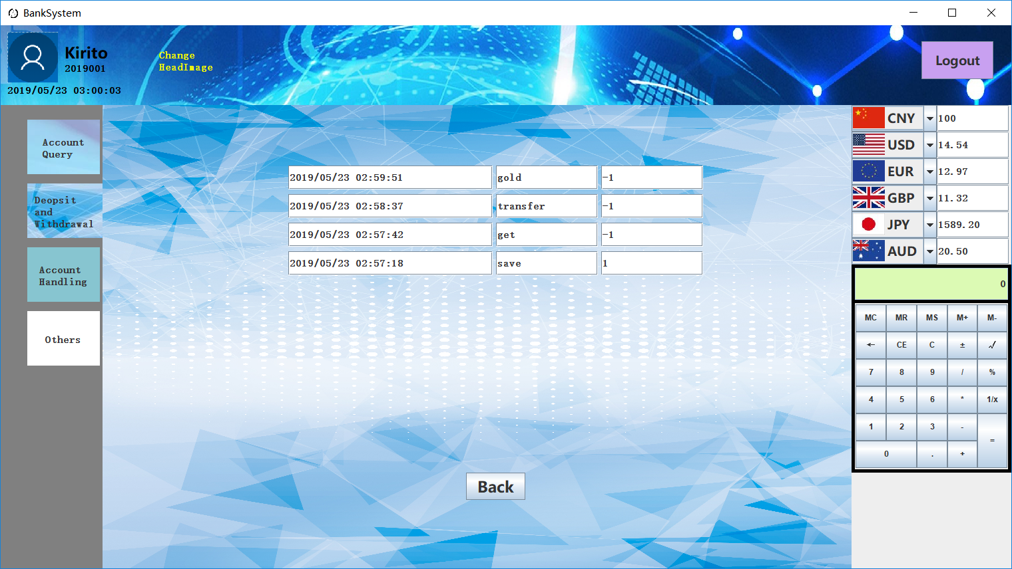
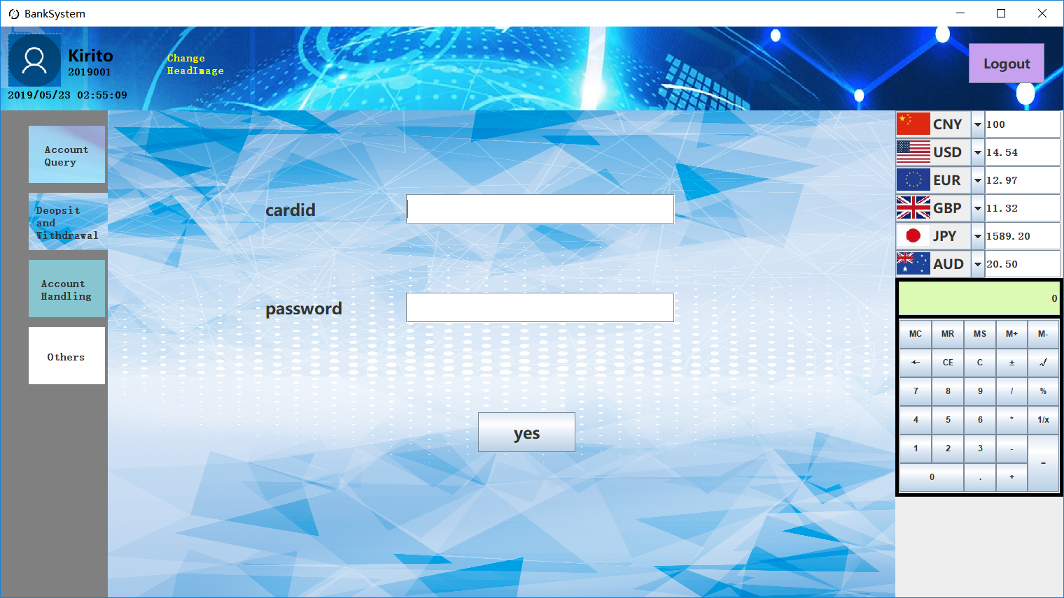
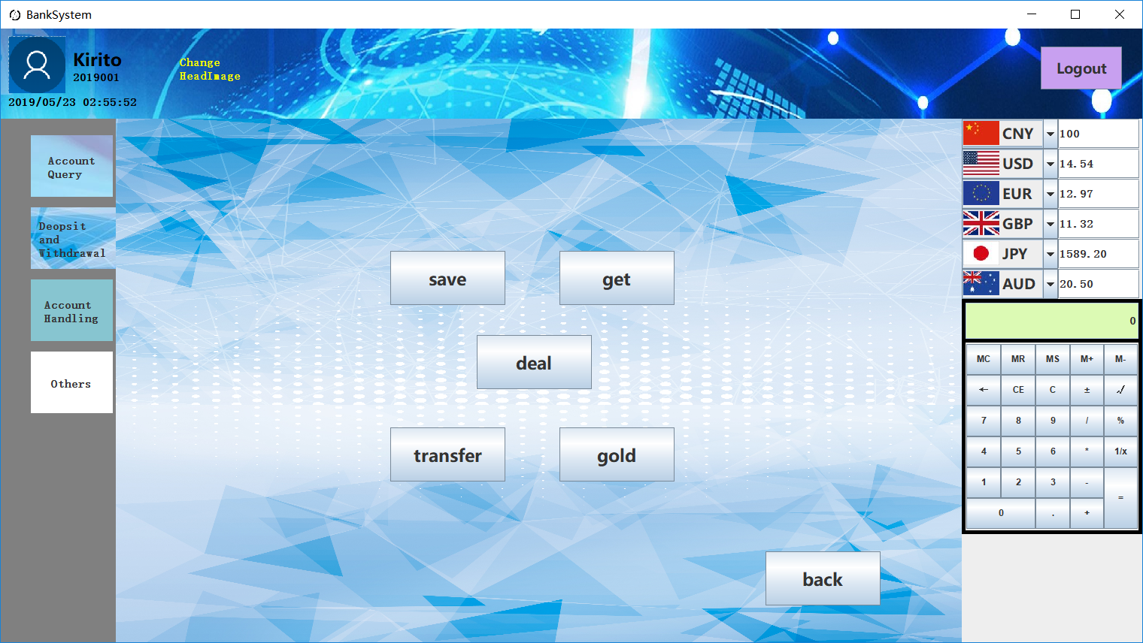

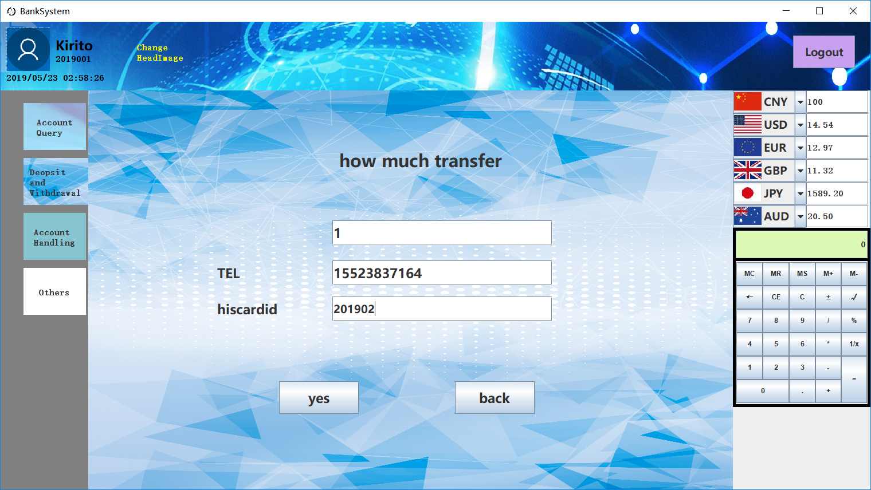
This is the query result of the business history.
Ask the customer to enter the card number and password to help him with his business.
Click on the corresponding button to handle the corresponding business

Slide 8
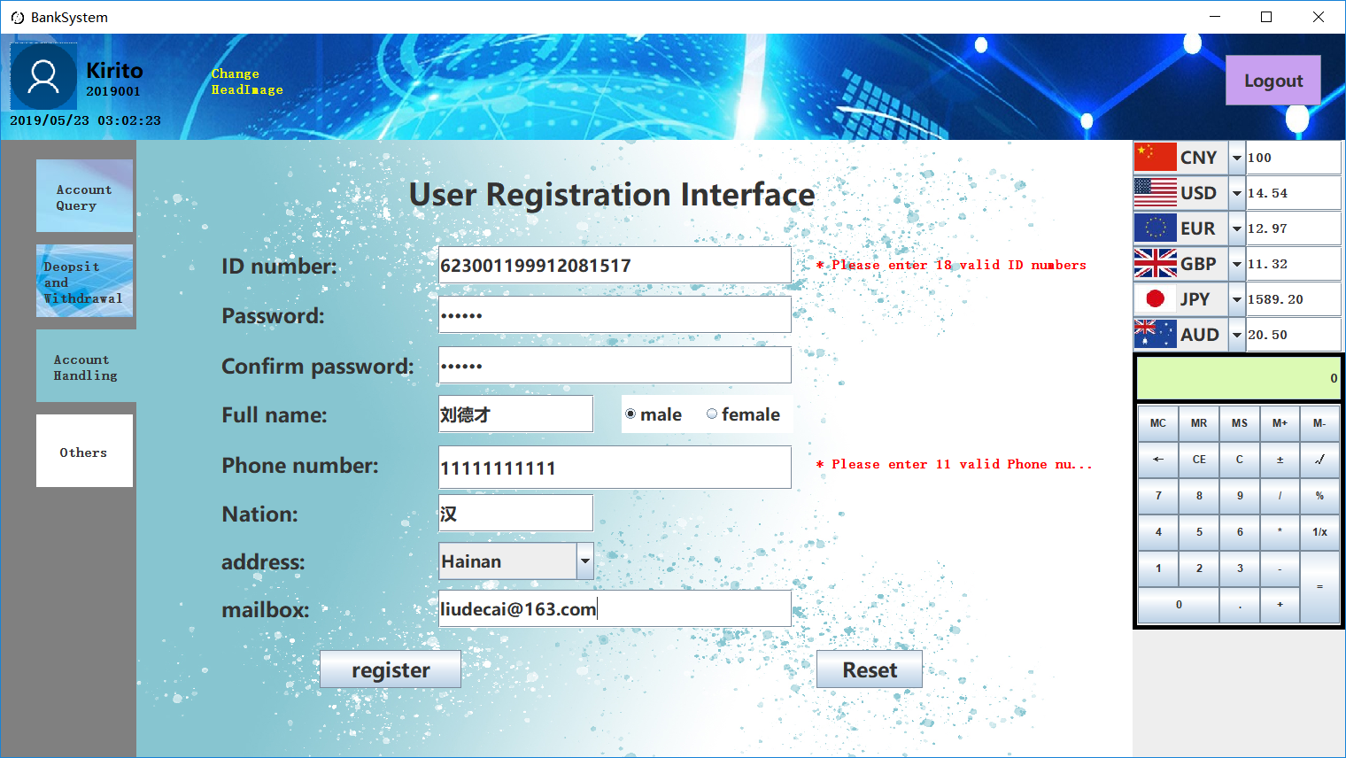

When a bank comes to a new customer, it can quickly create a new account by simply entering the customer processing interface and checking the identity information of the customer.
Use the query interface to ensure the successful creation of new customer information
NEXT→

Slide 9
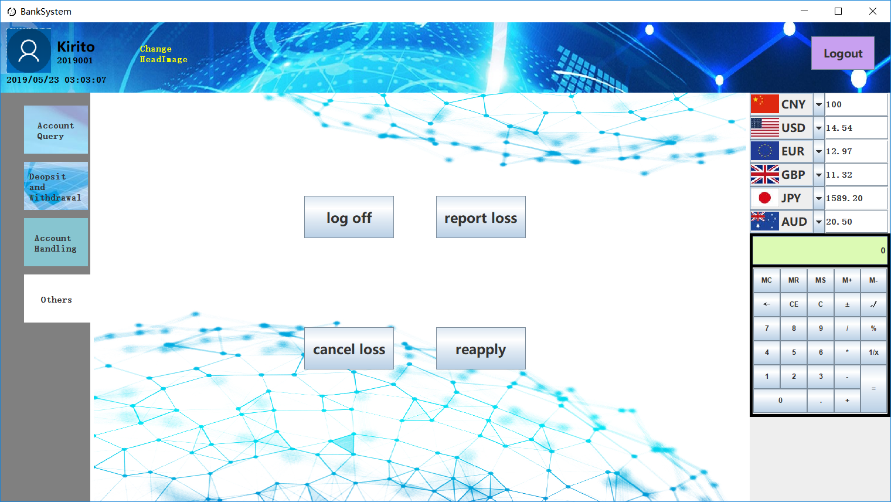
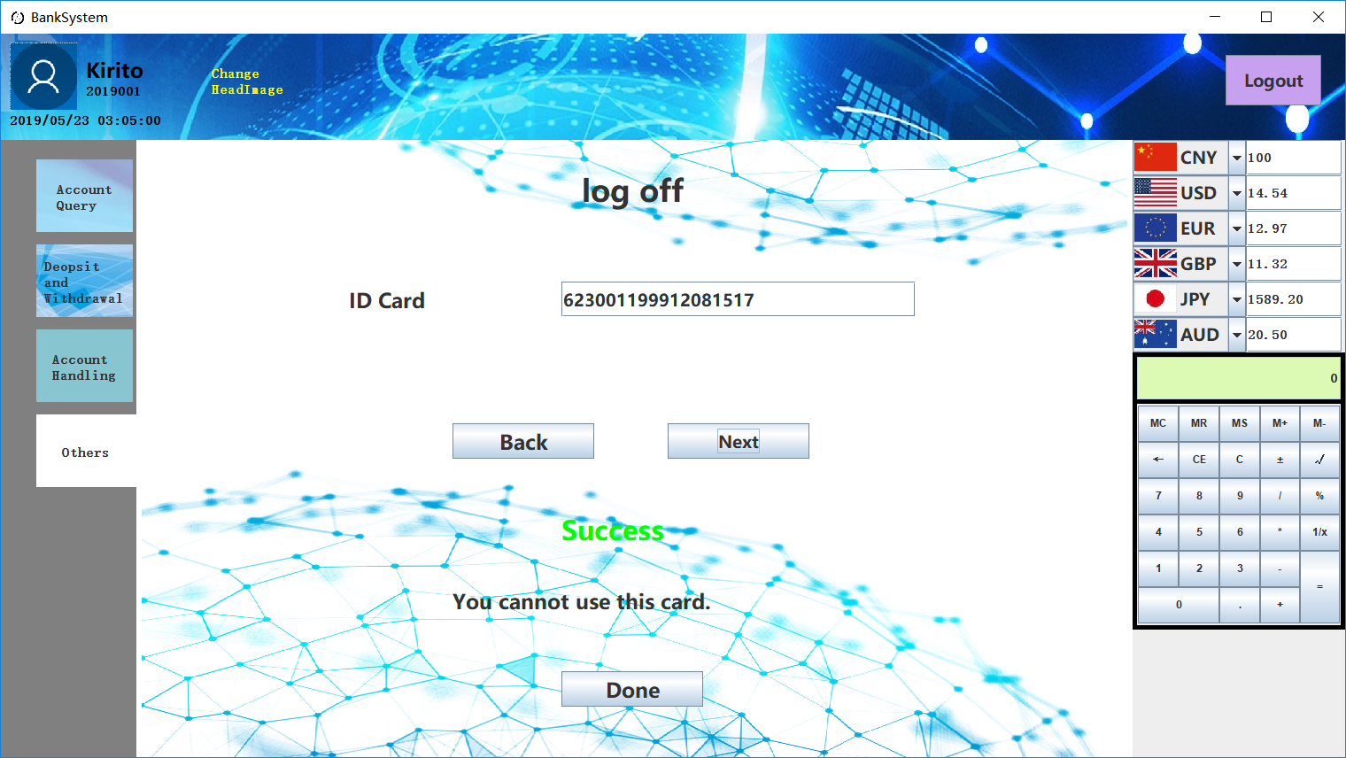

Use log off to write off customer information

Slide 10
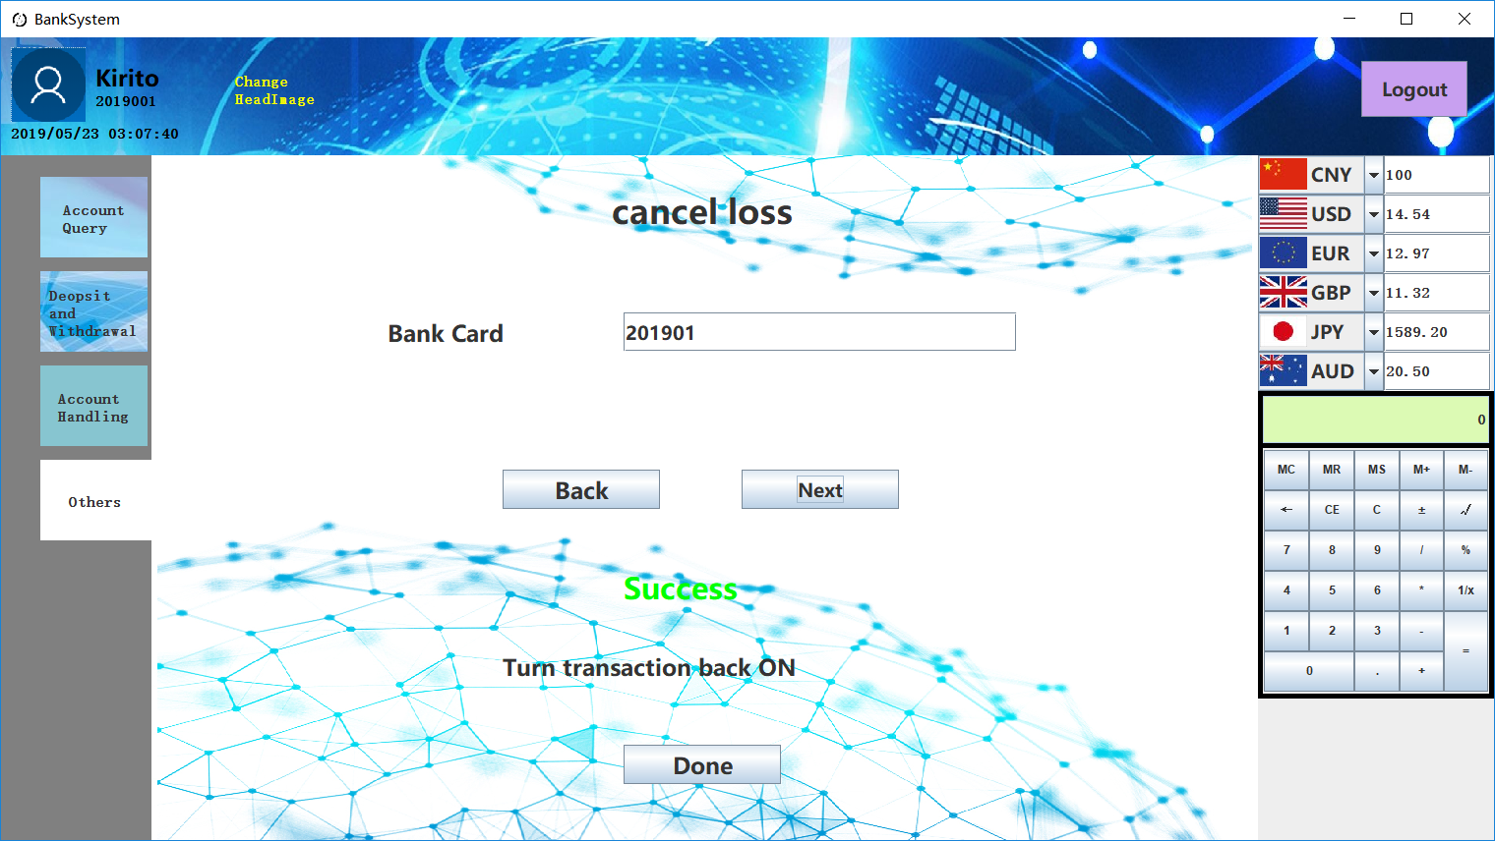
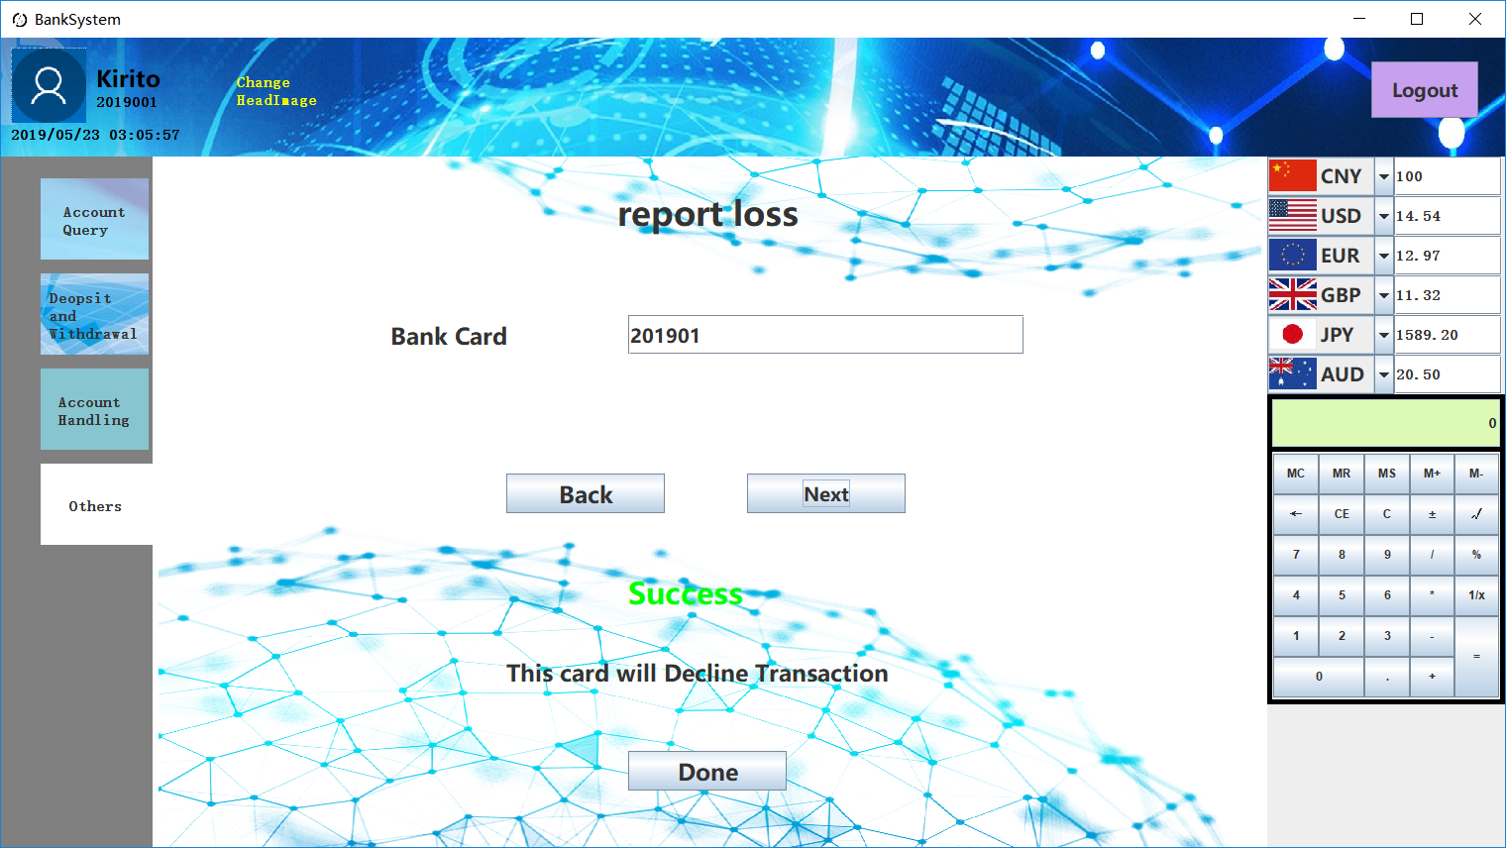
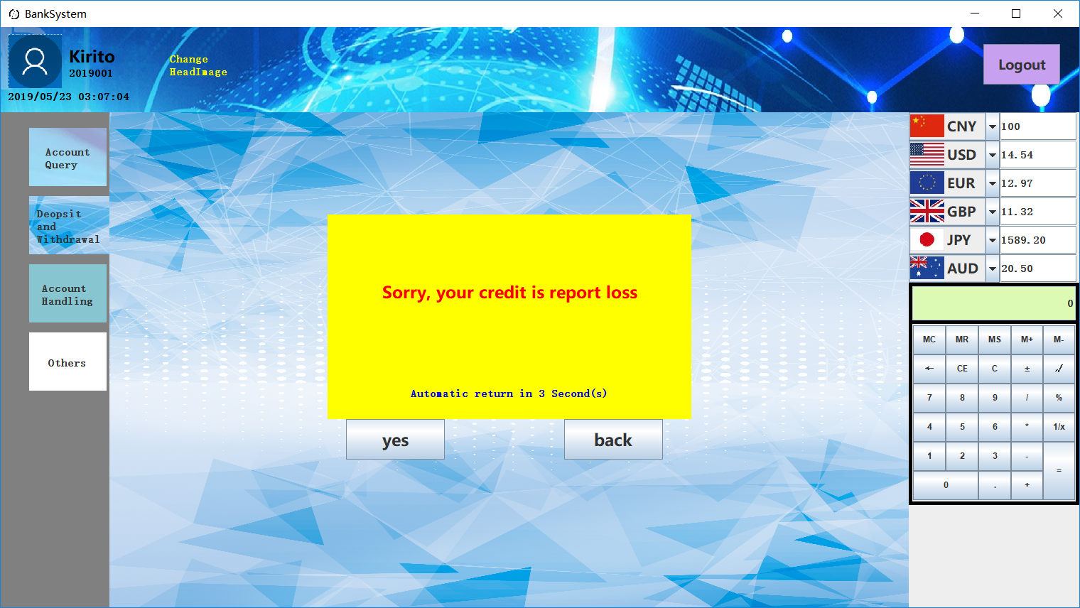
When the customer's bank card is lost, you can choose to register the unemployment for the customer, just click ‘REPORT LOSS’.
Of course, when the bank card is recovered, the loss report can be cancelled
When the bank card is in the state of loss reporting, it is impossible to handle the business of deposit and withdrawal.
NEXT→

Slide 11
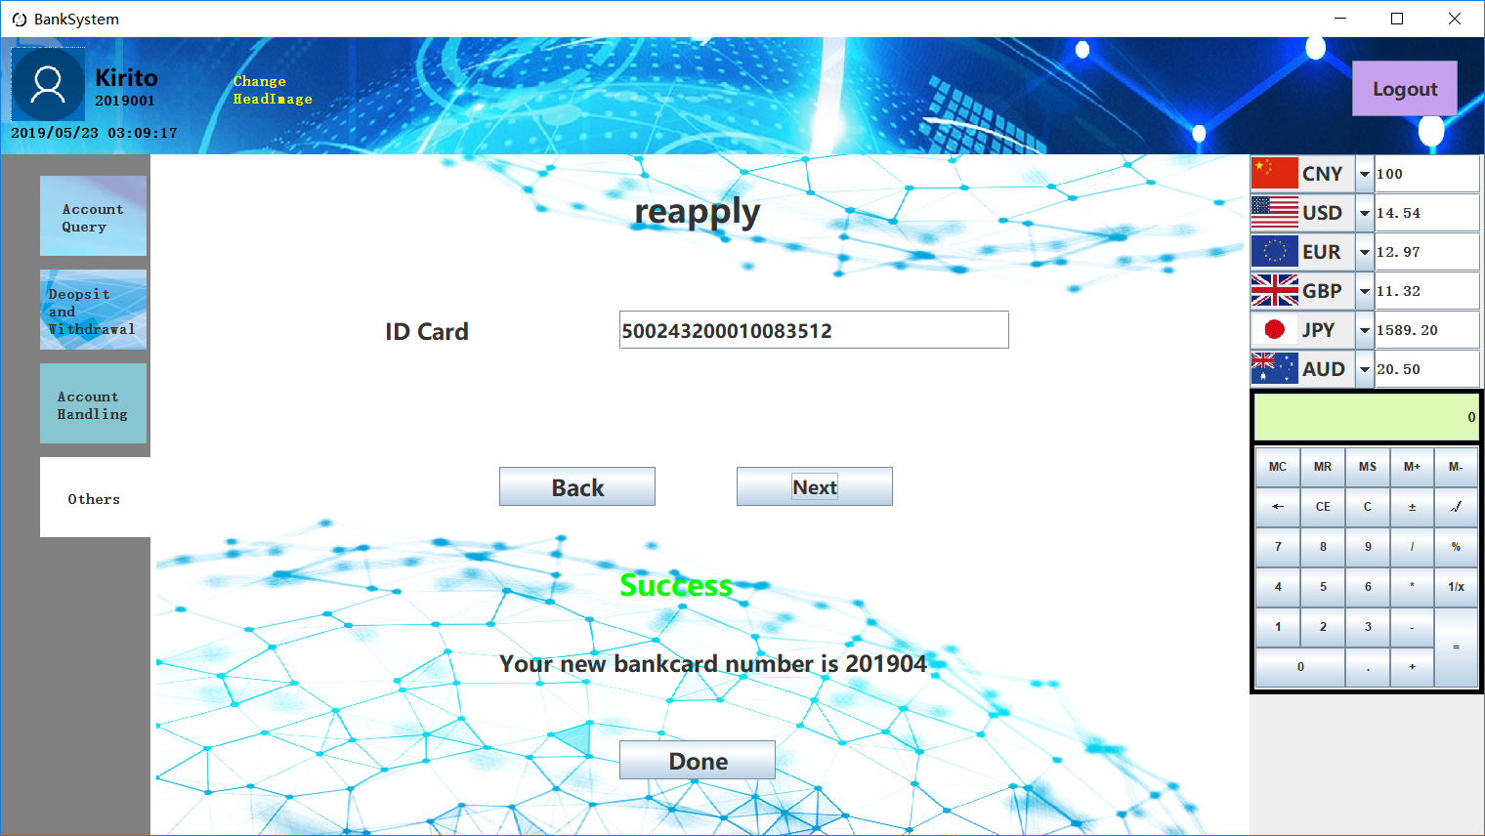
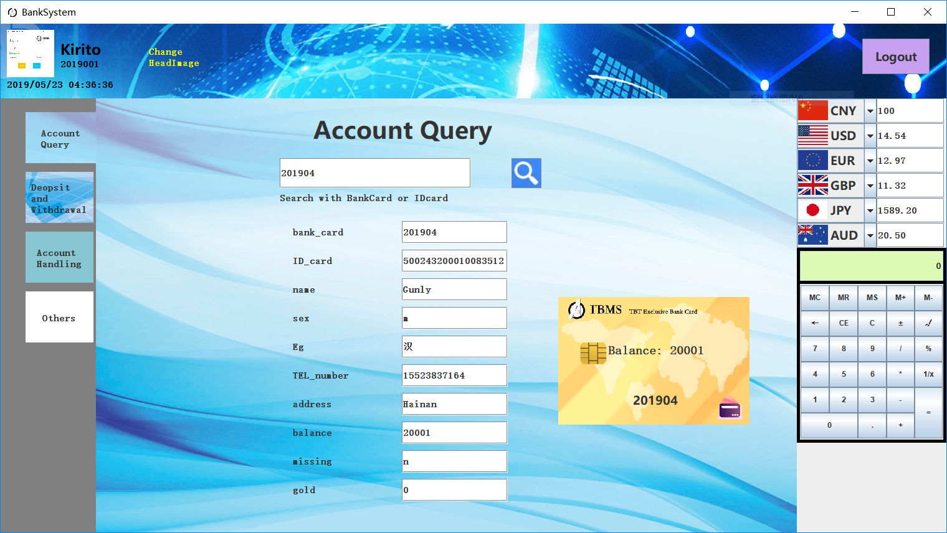
How to reapply a new bank card without changing the information? Just click the reapply button.
Use the query button to ensure that the new card information is correct
NEXT→

Slide 12
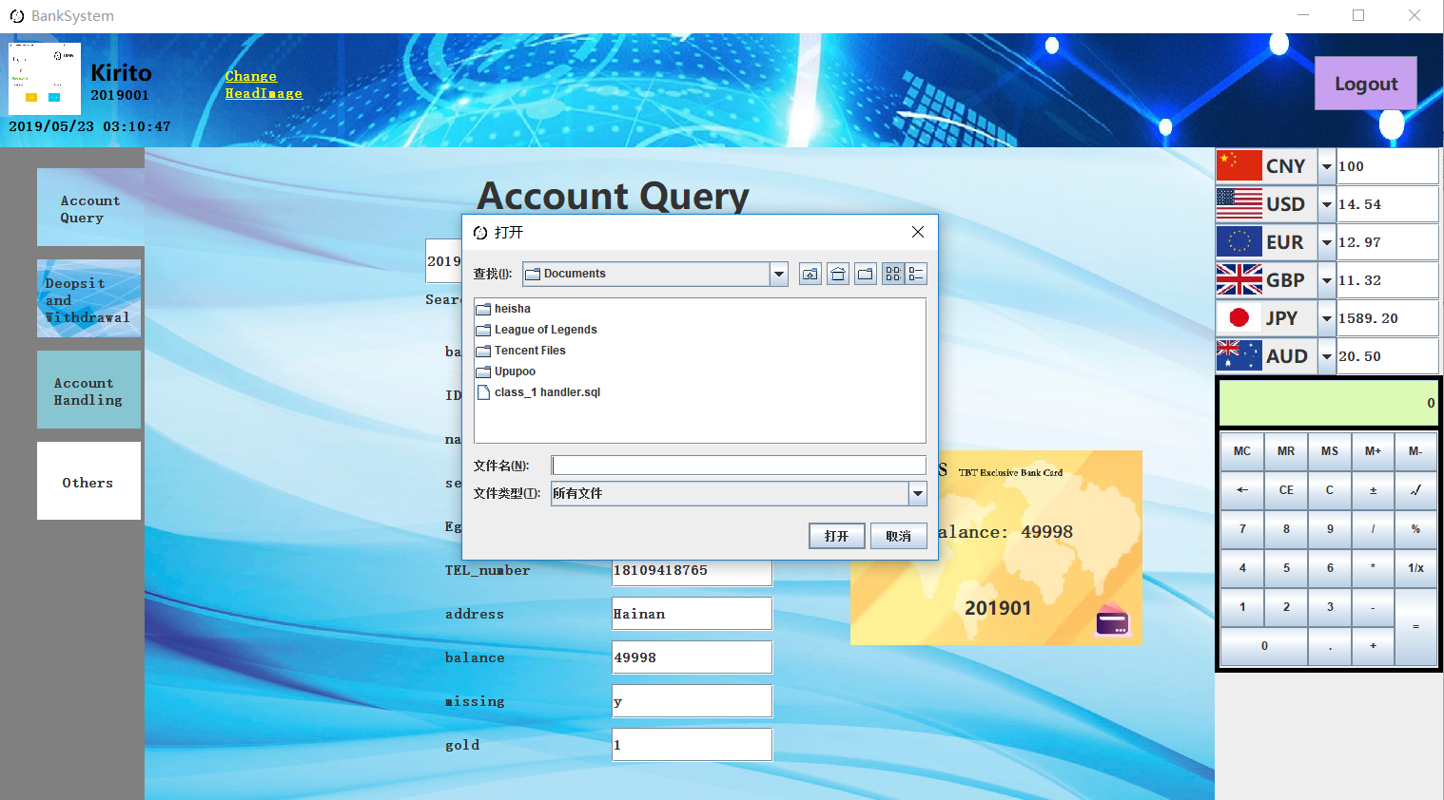

Use this button to select a favorite head-picture for yourself
NEXT→

Slide 13
Thank you for your patience.
We believe this software brings you more than that.
If you have any questions or suggestions in the use of the software,
please contact us:
1597230196@qq.com→Kirito
3241170791@qq.com→Gunly
2291054904@qq.com→Jerry
877586613@qq.com → Pual
Thanks for help
www.bilibili.com
m.csdn.net
www.baidu.com
www.zhihu.com
MR.Ashu
刘德才
Hainan University-NIIT
CREATED BY Kirito&Gunly
TBT GROUP

